Slide 1
Barreleye G2 2.0 OU system Thermal Simulation Report rev. R05

Slide 2
Revision control table
Rev. | Description | Owner | Date
R01 | Initial release | Honda | 2016/08/10
R02 | Change CPU power 250W → 225W ( IBM CPU Sku are 190W, 225W, and 300W). 2.5” SSD 4.1W K80 250W → 300W | Honda | 2016/08/15
R03 | Find thermal solutions to support SSDx24 PCS | Honda | 2016/08/22
R04 | Consolidate 2.5” HDDs support configuration. | Honda | 2016/08/31
R05 | G2-Sku2 configuration with x2 GPU P100 | Honda | 2016/09/07

Slide 3
Purpose and Condition
Purpose:
To simulate thermal situation of G2 Sku-2 configuration with x2 Nvidia P100.
Condition
1. All fan run and N+1 fan redundancy.
2. At ambient 35 ﾟC .
CFD Software:
FLOTHERM v11.1

Slide 4
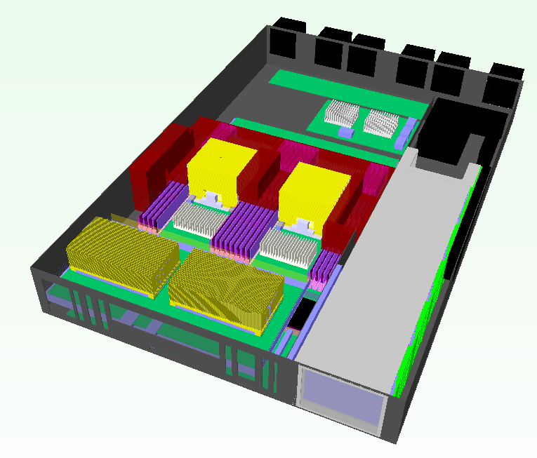
System placement
Fan1
Fan2
Fan3
Fan4
Fan5
Fan6
Expender Board
DIMM x32
CPU1
CPU2
VTM
VTM
2.5” HDD Drawer
Nvidia P100 *2
Power Brick
Air flow direction

Slide 5


System Inlet / Outlet venting
Venting (open ratio=60%)
Front view
Rear view

Slide 6


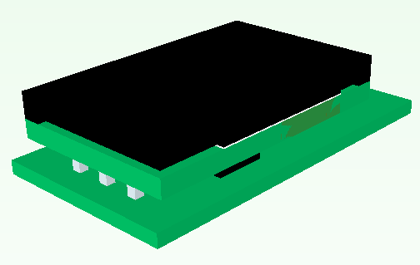
Power Brick model
Side view
Front view

Slide 7
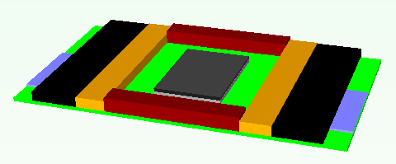
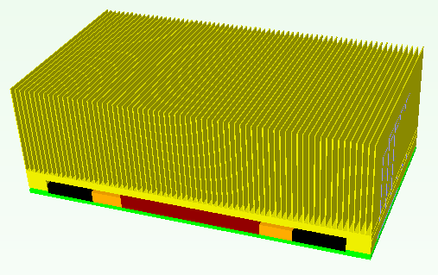
Nvidia P100 Flotherm model
Nvidia P100 Flotherm model
140 mm
36.7 mm
78 mm
Nvidia P100 with Copper heat-sink, x5 pipes

Slide 8
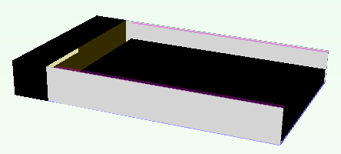
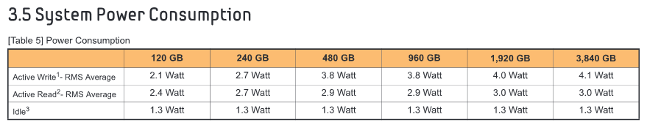
2.5” SSD model
Flotherm model
The height of SSD is 7mm.

Slide 9
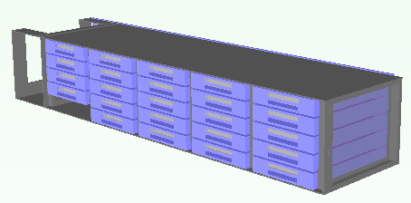
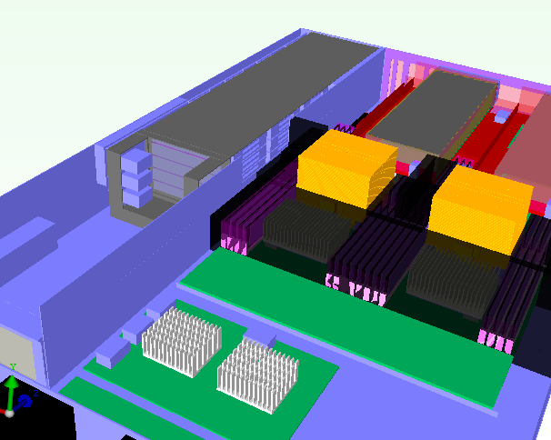
2.5” SSDs Support Location
HDD Q’ty x 24PCS
Sponge to prevent air flow bypass
Venting for HDD

Slide 10
System configuration
Component | TDP (watts) | Q’ty. | Note
Power CPU | 225 | 2 | Spec, Tj, 85C
Memory | 5 | 32 | Spec, Tc, 85C
2.5” SSD | 4.1 | 24 | SSD, Tc, 70C
Nvidia P100 | 300 | 2 | Spec, Chipset, Tc, 83C
VTM | 66 | 2 | Spec, Tc, 110C
6056 Fan |  | 6
Power Brick | 18.11 | 1 | Flotherm Model provided from vendor

Slide 11
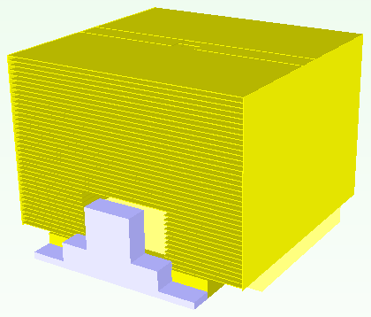
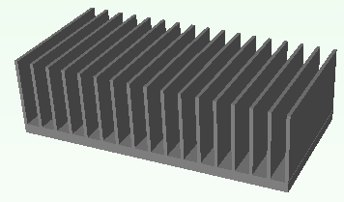
Thermal solution – Heat-sink
85 mm
90 mm
68.2mm
40 mm
CPU HSK
90 x 85x 68.2 mm
Copper base
Cu fin
Heat pipe x4
TIM: Pad K=7.7
VTM HSK
40x80x25 mm
Al extrusion (18 fins)
TIM: Pad K=1.75

Slide 12
Thermal solution – Heat-sink
57.3 mm
VTM HSK-2
57.3x80x32.6 mm
Al extrusion (18 fins)
TIM: Pad K=1.75

Slide 13
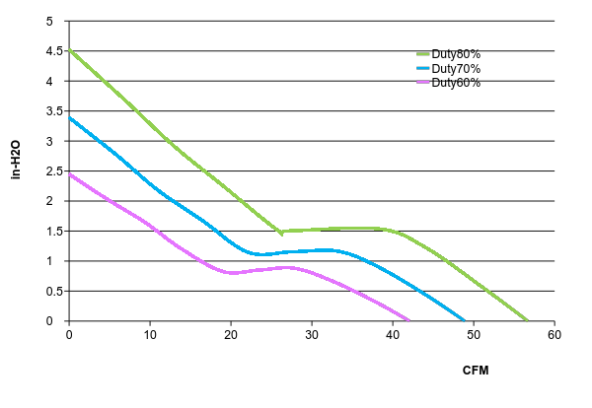
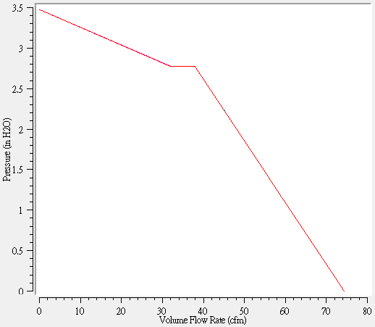
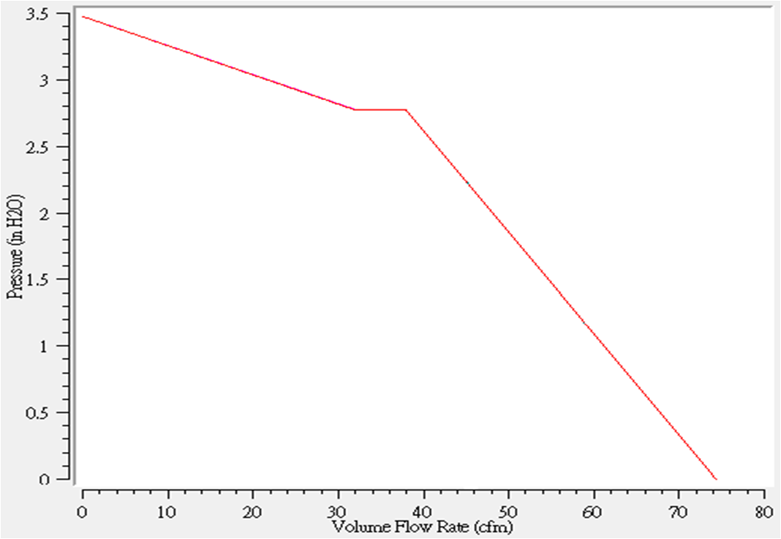
Thermal solution – FAN
PQ curve_PF60561BX-0000-S99_DS 60x60x56mm

Slide 14
Simulation Result – 2.5” SSD Config
Fan condition |  | Normal | Fan3 failed | Fan6 failed
System fan duty |  | 6fans, fan duty@100% | 5fans, fan duty@100% | 5fans, fan duty@100%
Simulation result | SPEC
Ambient Temp | NA | 35 | 35 | 35
CPU Power | NA | 225 | 225 | 225
CPU0 Inlet avg. | NA | 46.7 | 48.1 | 46.8
CPU0 Tj max | 85ﾟC | 79 | 80.5 | 80.5
CPU1 Inlet avg. | NA | 51.9 | 53.7 | 53.2
CPU1 Tj max | 85ﾟC | 81.2 | 83 | 82.7
DIMM Temp (Max.) | 75ﾟC | 48.9 | 49.9 | 50.3
VTM Temp(Max.) | 100ﾟC | 92.3 | 94.2 | 94.1
2.5" SSD Temp (Max.) | 70ﾟC | 64.4 | 68.4 | 67.3
Power Brick, HSP Temp | 115ﾟC | 57.8 | 59.7 | 59.6
SAS chipset Temp | 105ﾟC | 67.4 | 70.1 | 71
P100-1 Chipset temp | 83 | 82.4 | 84.0 | 83.9
P100-2 Chipset temp | 83 | 81.5 | 83.1 | 83

Slide 15
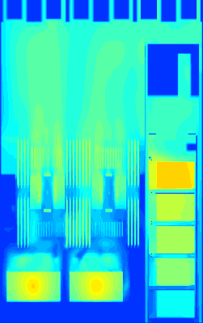
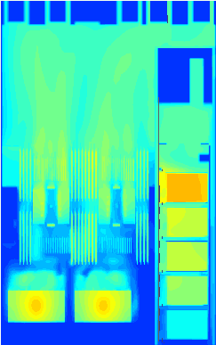
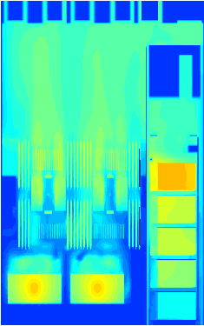
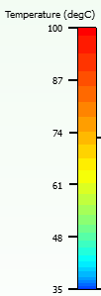

Temperature Profile_overall
Y=40mm

Slide 16



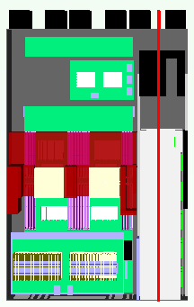
Temperature Profile _ HDD zone
X=450mm
6 fans
5 fans (Fan3 fail)
5 fans (Fan6 fail)

Slide 17
Simulation Result –Temperature
Conclusion :
CPUs temperature can meet IBM CPU spec at normal fan condition and one fan failed condition.
2.5” SSD can support to Max. config (24 PCS).
Nvidia P100 can meet vendor spec at normal fan condition, but over T-case spec about 1 degree C at N+1 fan redundancy.
Other components can meet thermal spec.
Next action item:
Will use larger P100’s heat sink.
Study 2.5” PCIe SSD power downgrade to 20W.

